Slide 1
Cardiac Disease Risk Prediction
Guided by : Milind Kapse Sir
Presented By:
Kaushik Dash – 250243025016
Sarim Ur Rehman – 250243025034
Utkarsh Jain – 250243025049
Vibhav Singh – 250243025052

Slide 2
Contents
Problem Statement
Introduction
Technologies Used
Work Flow
EDA
Data Modeling
Model Performance
Deployment
Web Application
Conclusion

Slide 3
Problem Statement
Cardiovascular diseases often go undetected until it’s too late. This project aims to use machine learning to predict heart disease risk from patient data, enabling earlier identification and better care.

Slide 4
Introduction
Heart disease remains the top cause of death globally, often because it’s discovered too late.
Our project leverages machine learning to analyse simple health data—like age, food habits, alcohol consumption, stress etc. —to predict heart disease risk.
This helps doctors spot high-risk patients sooner, allowing for earlier intervention and improving patient outcomes.

Slide 5
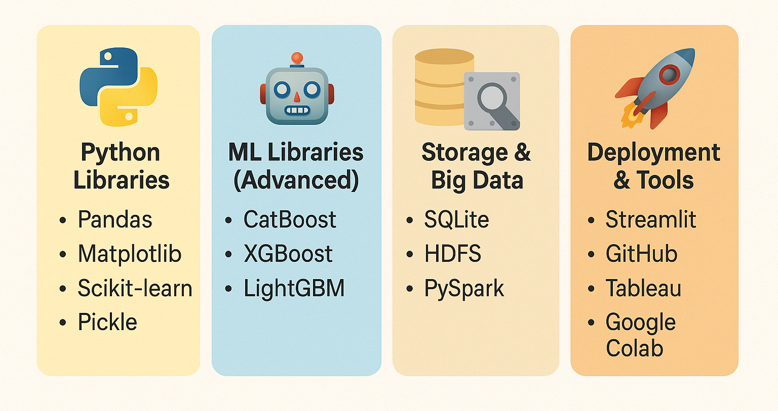
Technologies Used

Slide 6
Work Flow
CSV Data
Dump SQLite & HDFS
Hyperparameter Tuning
EDA
Model Training
Data Preprocessing
Model
Training Data
Prediction
Cleaned Data
Pickle File
Evaluation
Testing Data
Streamlit UI

Slide 7
Work Flow Cont.
EDA – Explored the dataset to understand variable distributions, correlations, and outliers.
Preprocessing – Handled missing values & outliers, encoded categorical variables, feature engineering.
Modelling – Trained multiple ML models for heart disease prediction.
Evaluation – Assessed model performance using accuracy, recall etc.
Comparison – Compared different models to select the best-performing algorithm.
Deployment – Deployed the final model as an interactive Streamlit web application.

Slide 8
EDA (Exploratory Data Analysis)
Total Records : 308854
Total Features : 19
Numerical : Height, Weight, BMI, Alcohol Consumption, Fruit Consumption, Green Vegetable Consumption, Fried Potato Consumption
Categorical : General Health, Checkup, Exercise, Heart Disease, Skin Cancer, Other cancer, Depression, Diabetes, Arthritis, Sex, Age Category, Smoking History.
Target : Heart Disease

Slide 9
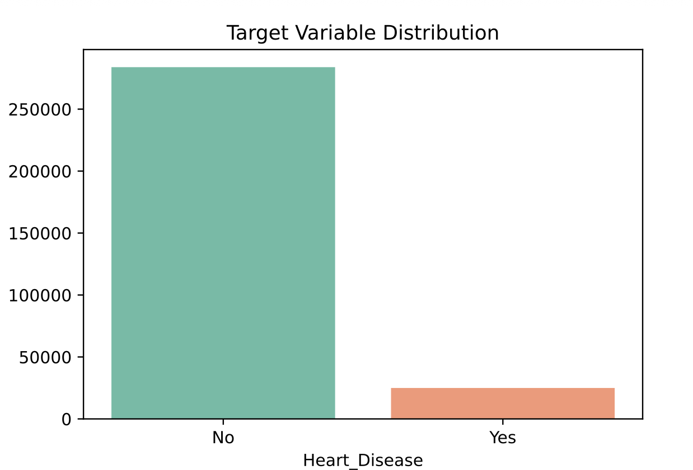
EDA cont…
Heart Disease Distribution
Yes : 8.08%
No : 91.92%

Slide 10
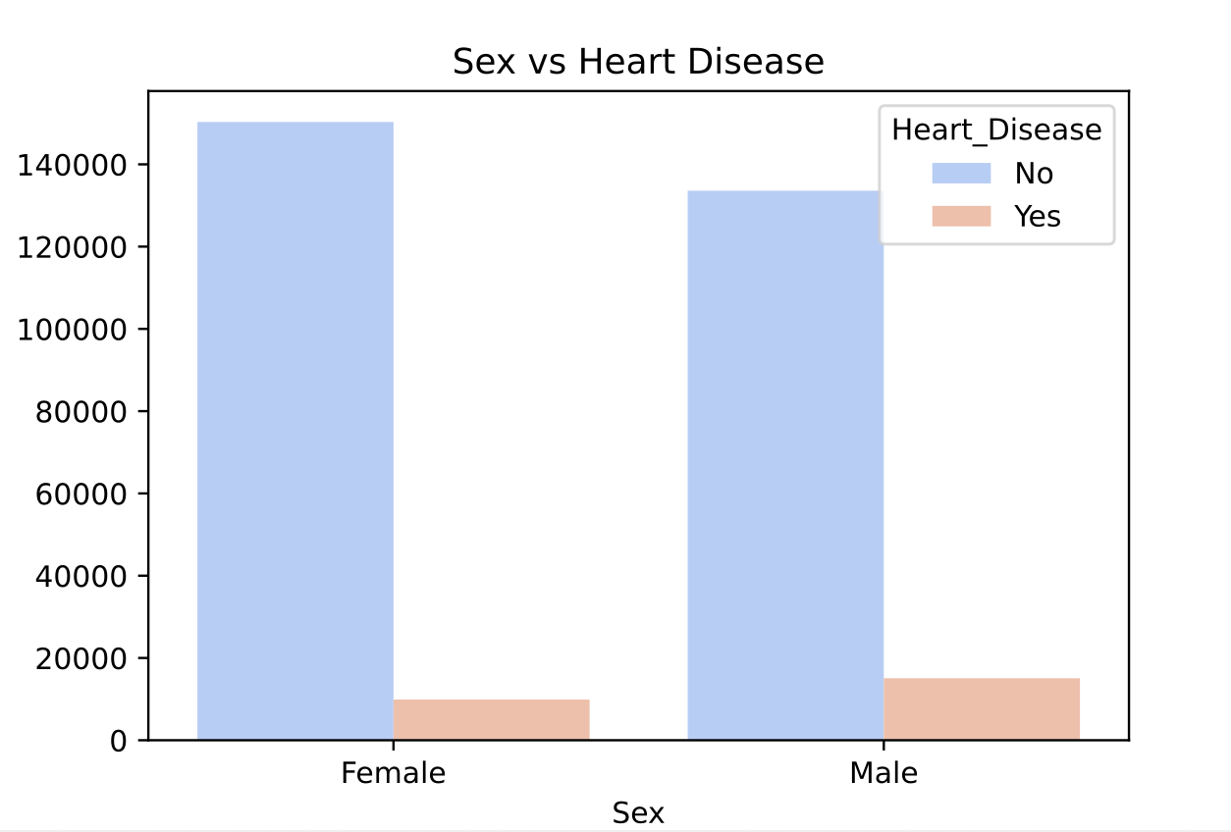
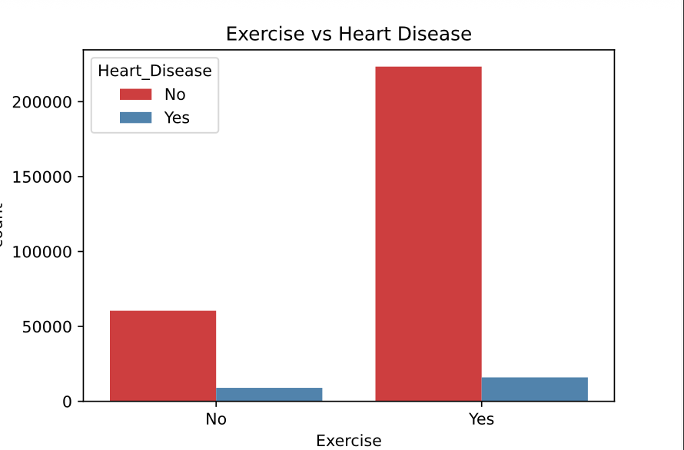
EDA cont...
Male : 60.36%
Female : 39.64%
Exercise NO : 36.06%
Exercise YES : 63.94%

Slide 11
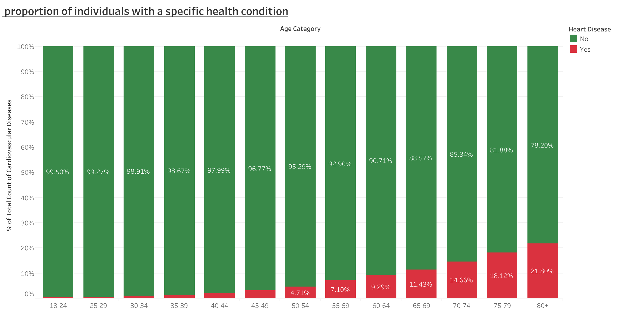
EDA – Age vs Heart Disease cont…

Slide 12
Data Modeling
Simple Models
Logistic Regression | Predicts probabilities using a sigmoid curve (linear decision).
K-Nearest Neighbours | Classifies based on the nearest data points (distance-based).
Decision Tree | Splits data into branches based on feature values.
Naive Bayes | Uses probability and Bayes’ theorem assuming feature independence.
SVM (Support Vector Machine) | Finds the best boundary (hyperplane) to separate classes.
Ensemble Models
Random Forest | Combines multiple decision trees using bagging to reduce overfitting.
AdaBoost | Focuses on misclassified points by boosting weak learners.
Gradient Boosting | Builds trees sequentially to fix previous errors (e.g., XGBoost).
LightGBM | A fast, efficient gradient boosting model using histogram-based splits.
CatBoost | Handles categorical data efficiently with gradient boosting.

Slide 13
Model Performance & Hyperparameters
Model | Best Parameters | Log loss | Recall | Accuracy | ROC AUC
Adaboost | {'estimator__class_weight': 'balanced', 'estimator__max_depth': 4, 'learning_rate': 0.1, 'n_estimators': 50} | 0.57 | 0.78 | 0.73 | 0.81
Catboost | {'depth': 8, 'iterations': 500, 'l2_leaf_reg': 1, 'learning_rate': 0.1} | 0.45 | 0.73 | 0.76 | 0.82
XGboost | {'colsample_bytree': 0.6, 'learning_rate': 0.05, 'max_depth': 5, 'n_estimators': 200, 'subsample': 0.6} | 0.50 | 0.80 | 0.73 | 0.83
Random Forest | {'max_depth': 10, 'min_samples_leaf': 2, 'min_samples_split': 2, 'n_estimators': 200} | 0.48 | 0.77 | 0.74 | 0.83
Decision Tree | {'criterion': 'gini', 'max_depth': 15, 'min_samples_leaf': 1, 'min_samples_split': 2} | 1.32 | 0.77 | 0.74 | 0.72
Logistic Regression | {'C': 0.001, 'class_weight': 'balanced', 'penalty': 'l2', 'solver': 'lbfgs'} | 0.51 | 0.78 | 0.73 | 0.83
KNN | {'metric': 'manhattan', 'n_neighbors': 3, 'weights': 'distance'} | 1.83 | 0.13 | 0.90 | 0.64
Naïve Bayes | {'var_smoothing': np.logspace(0, -9, num=100)} | 0.25 | 0.16 | 0.91 | 0.80
SVM | {C=1, gamma='scale', kernel='rbf', class_weight='balanced',random_state=1, probability=True} | 0.52 | 0.82 | 0.71 | 0.82

Slide 14
Deployment
Streamlit is an open-source Python library for building interactive web apps
Built an interactive web app using Streamlit
Integrated trained model using Pickle
Real-time predictions with clean user input interface
Embedded Tableau Dashboard for data insights

Slide 15
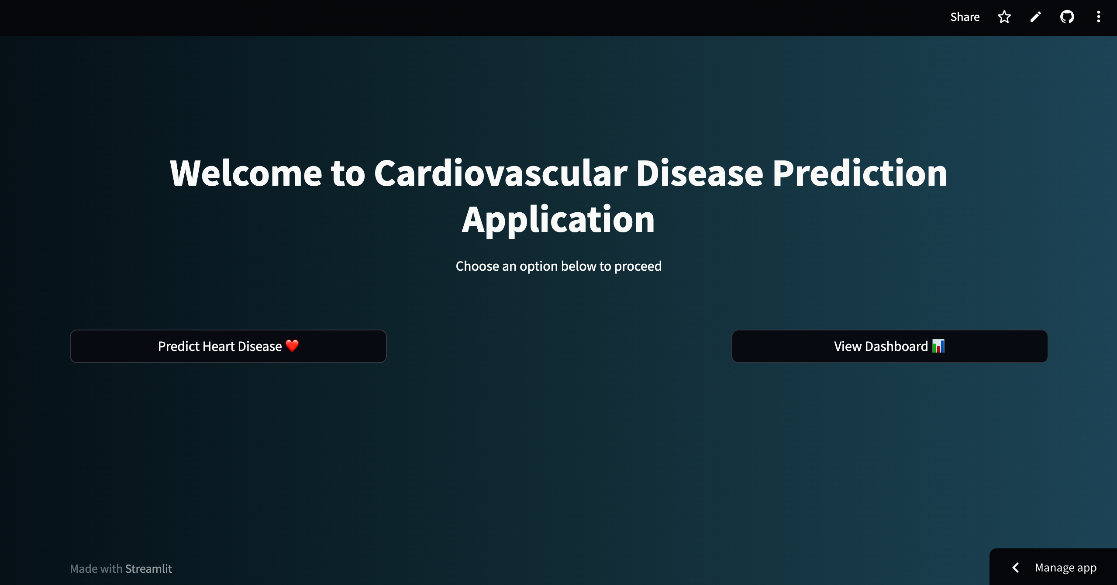
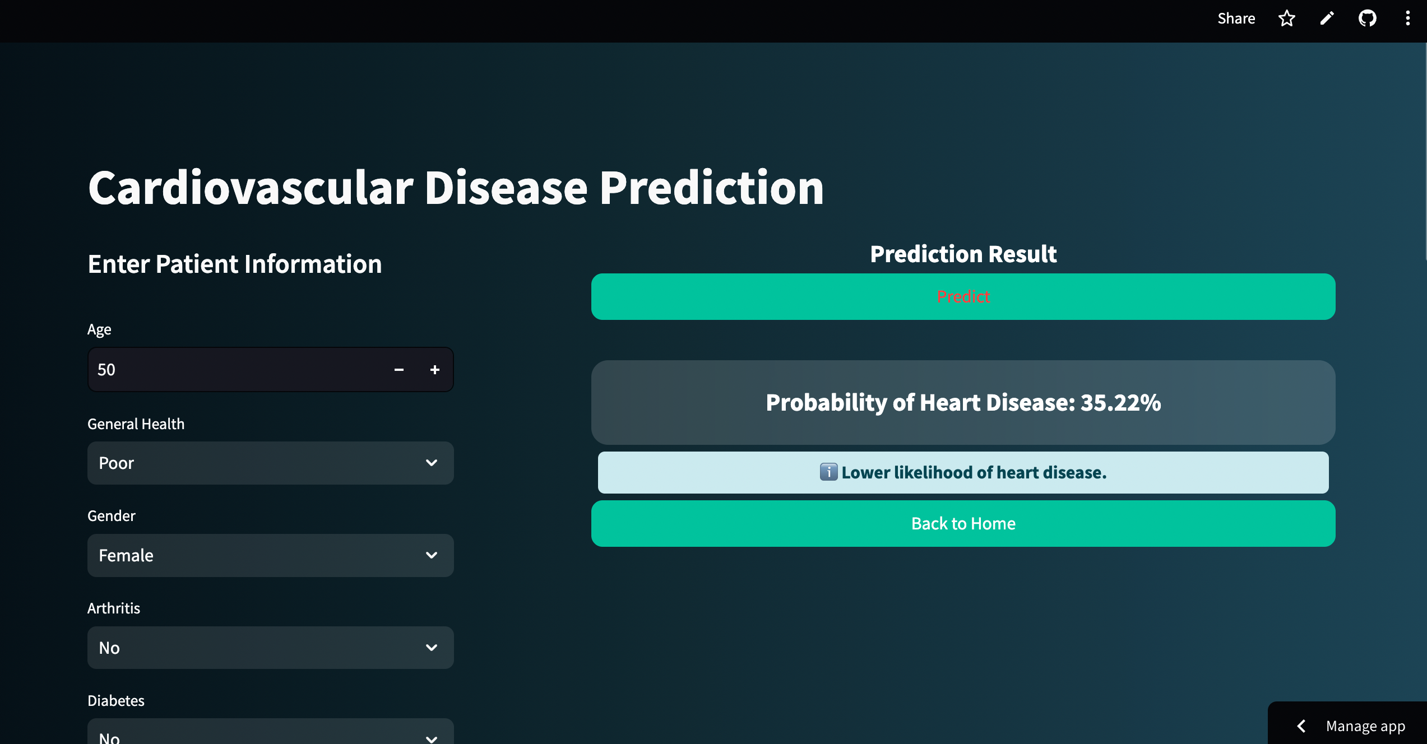
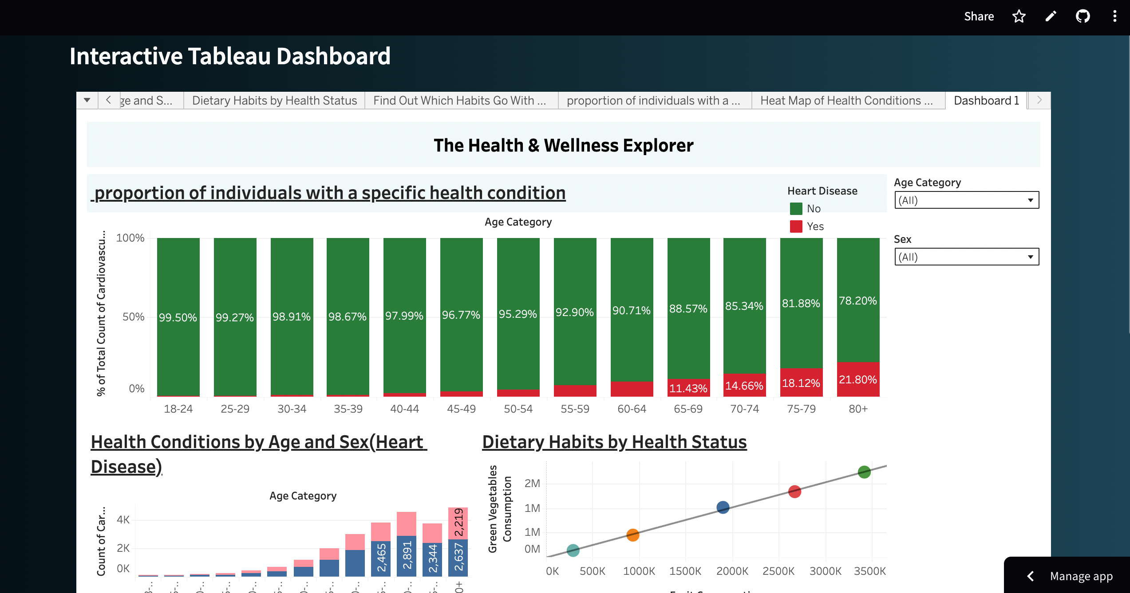
Web Application

Slide 16
Conclusion & Future Scope
The XGboost model demonstrated strong performance in predicting disease, achieving recall of 0.80 , accuracy of 0.73.
Robust data preprocessing and hyperparameter tuning contributed to the model's success.
Real-time Implementation: Implement the model in a real-time system for predicting the risk of heart disease.
Model Enhancement: Explore advanced algorithms such as Neural Network to further improve prediction accuracy or Training model on more dataset for better feature learning.

Slide 17

Thank You

